Slide 1


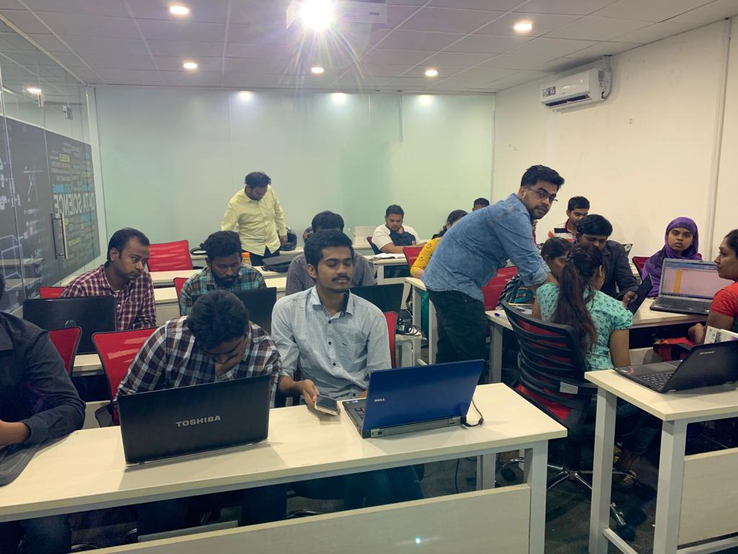

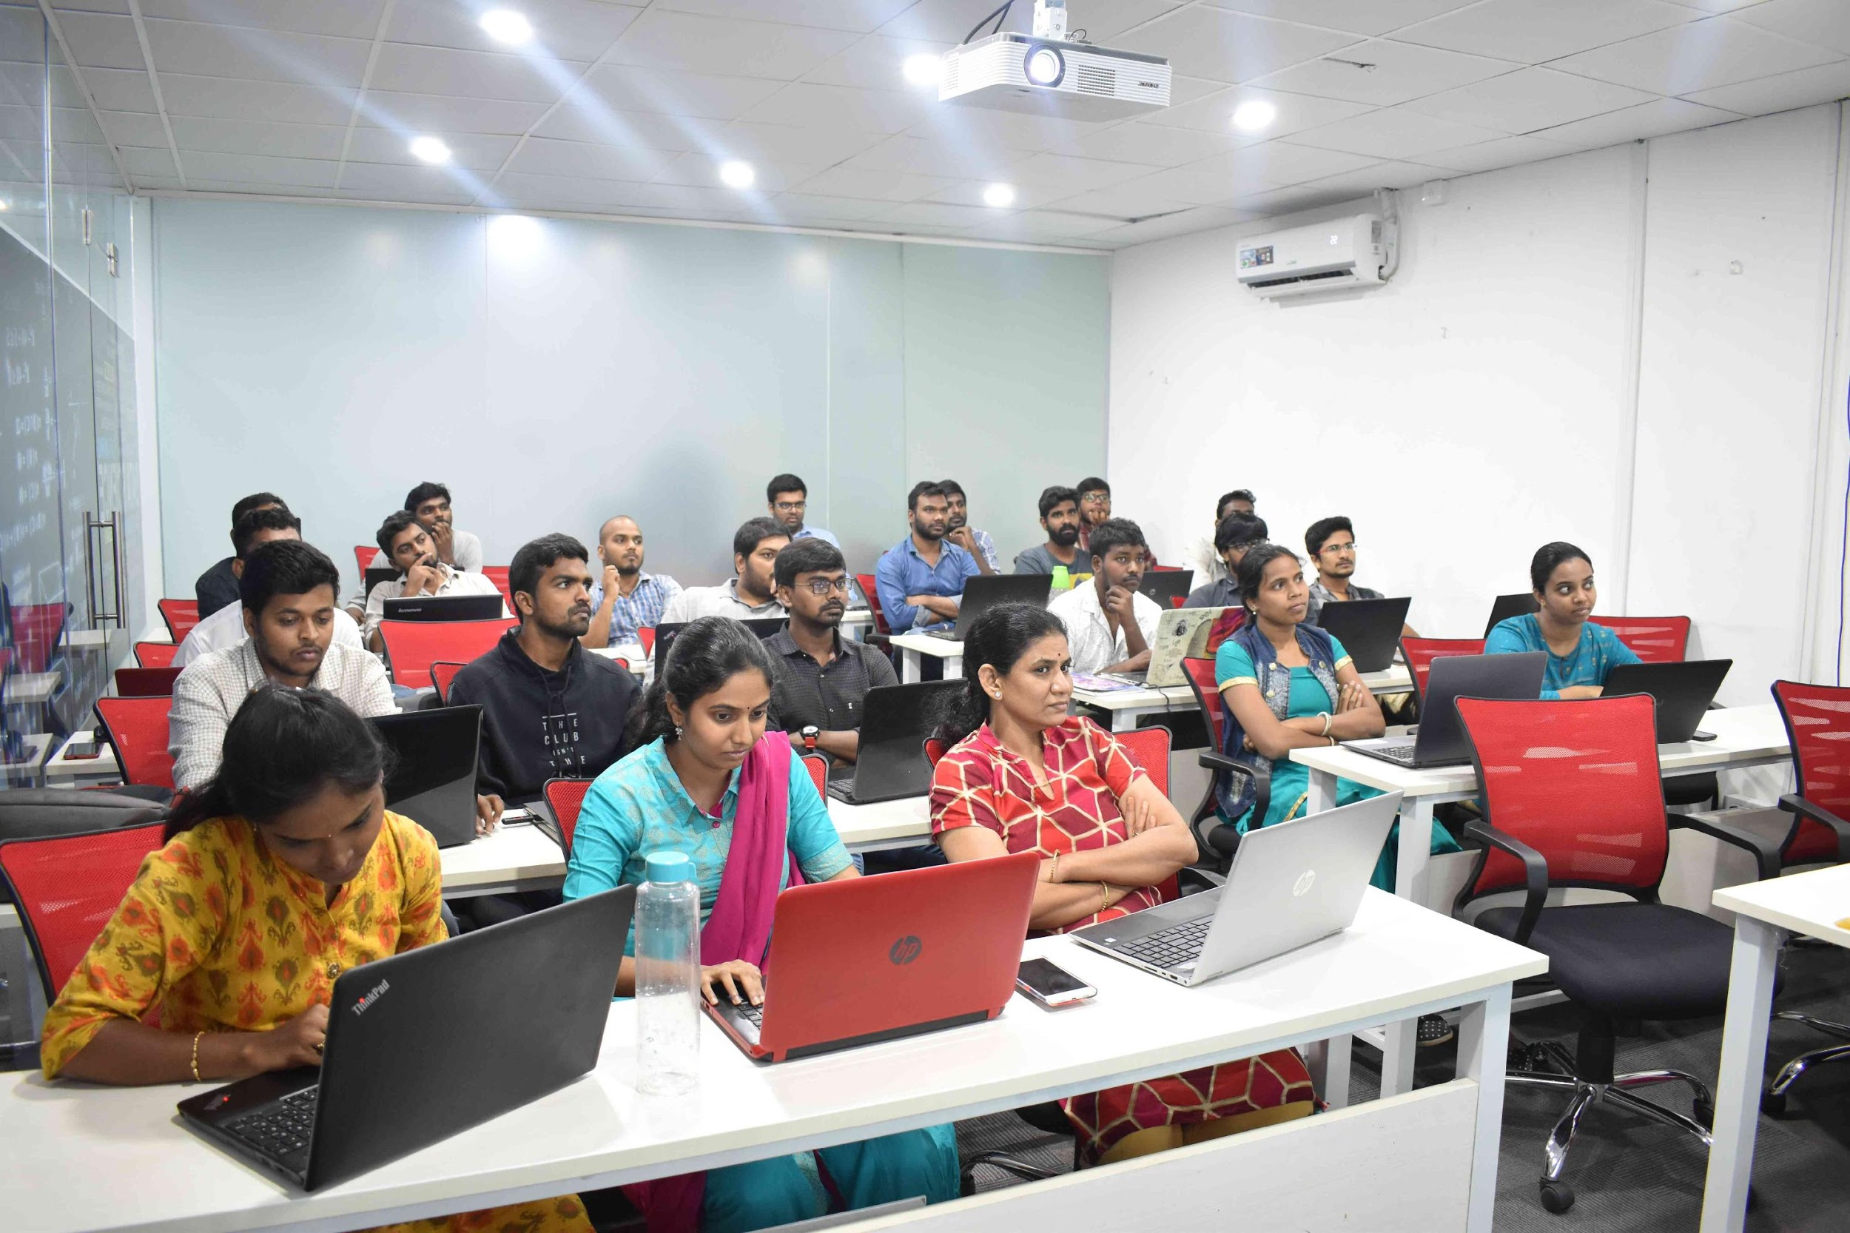
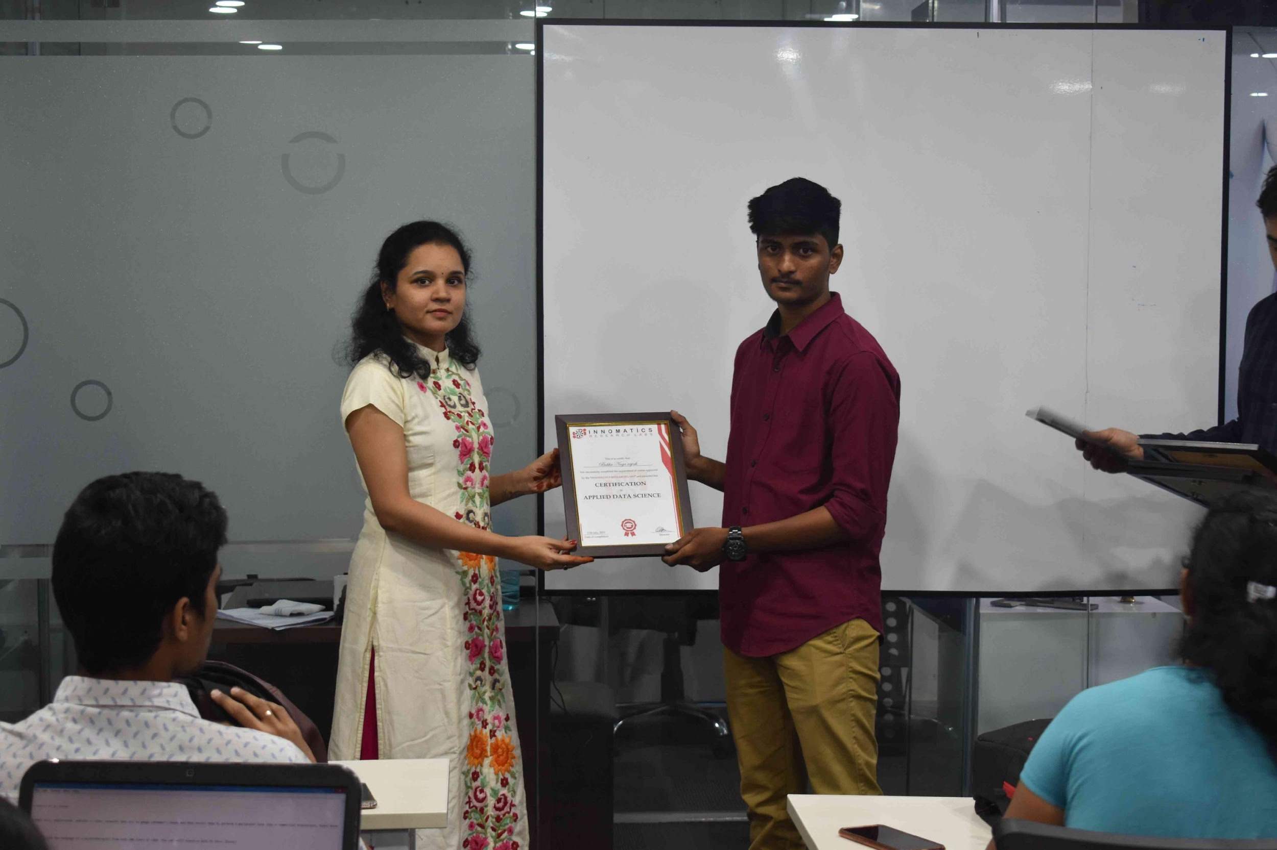
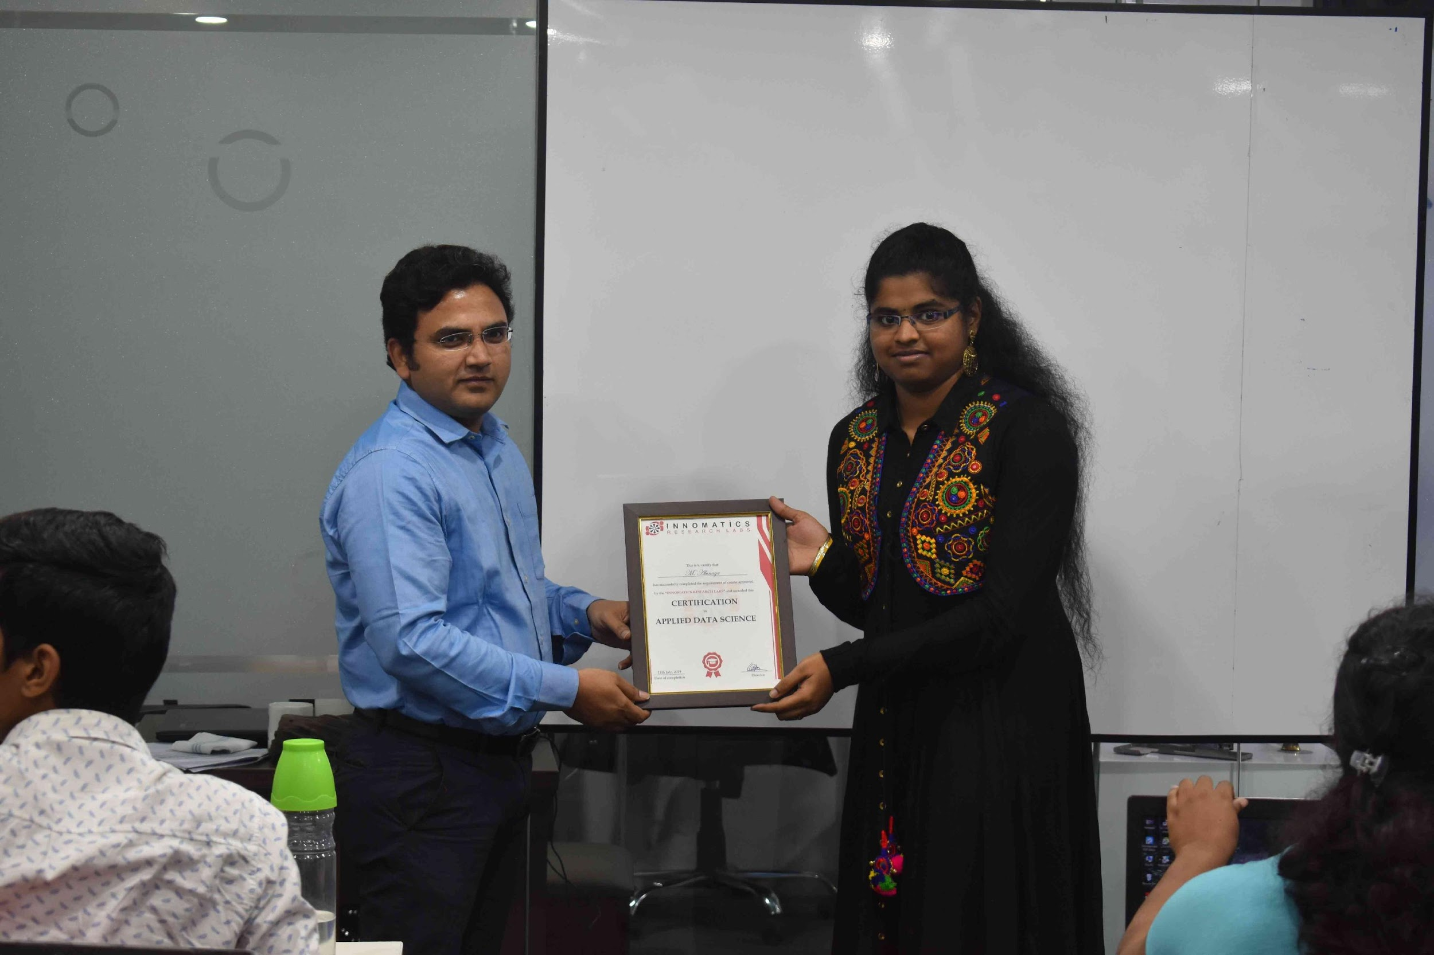

Slide 2
Looking For Hotels in Bangalore
Web Scraping of Data from Booking.com
By
Sanjeev Kumar Nath

Slide 3
Topics To Be Discussed
Extracting Raw Data and Cleaning
Data Visualisation
Conclusion

Slide 4
Extracting Raw Data and Cleaning
Website Used to extract data is Booking.com
URL used to Extract Raw Data :- “https://www.booking.com/searchresults.en-gb.html?sid=a51a365feffa9a8d3a49da8ce5239e6d&aid=355028&lang=en-gb&sb=1&sb_lp=1&src=index&src_elem=sb&error_url=https%3A%2F%2Fwww.booking.com%2Findex.en-gb.html%3Faid%3D355028%26sid%3Da51a365feffa9a8d3a49da8ce5239e6d%26sb_price_type%3Dtotal%3Bsrpvid%3D93ed82dc83df0086%26%26&ss=Bangalore&is_ski_area=0&ssne=Bangalore&ssne_untouched=Bangalore&dest_id=-2090174&dest_type=city&checkin_year=2022&checkin_month=7&checkin_monthday=1&checkout_year=2022&checkout_month=7&checkout_monthday=2&group_adults=2&group_children=0&no_rooms=1&b_h4u_keep_filters=&from_sf=25&offset=0”
Raw Data Obtained from website :-
Data Obtained after Cleaning :-

Slide 5
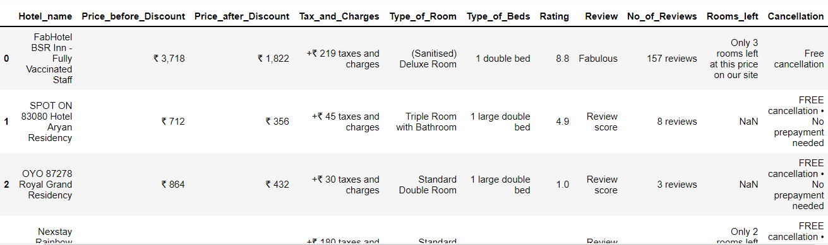
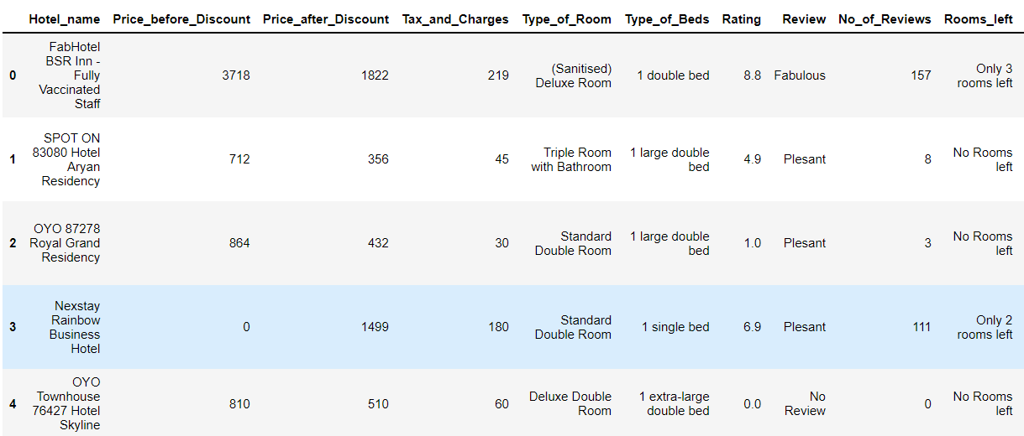
Comparing Raw Data and Cleaned Data
Raw Data
Cleaned Data

Slide 6
Things people keep in mind before booking a hotel
Fixed Budget.
Good Ratings.
A Good Room.
Discount If Available.

Slide 7
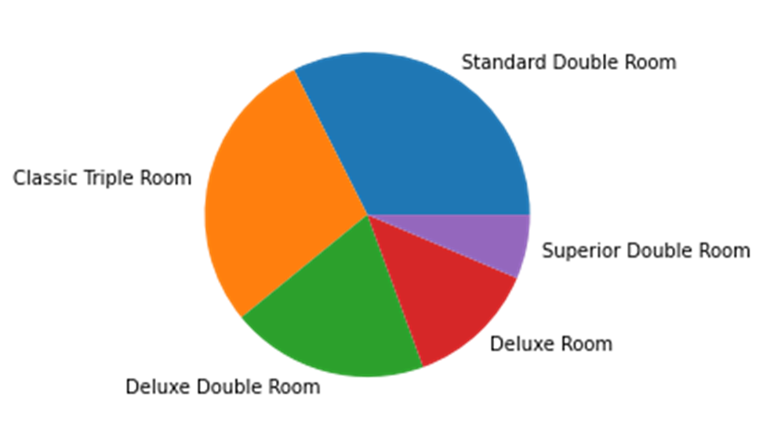
Different Types of Rooms Available
These types of rooms are mostly available in different Hotels

Slide 8
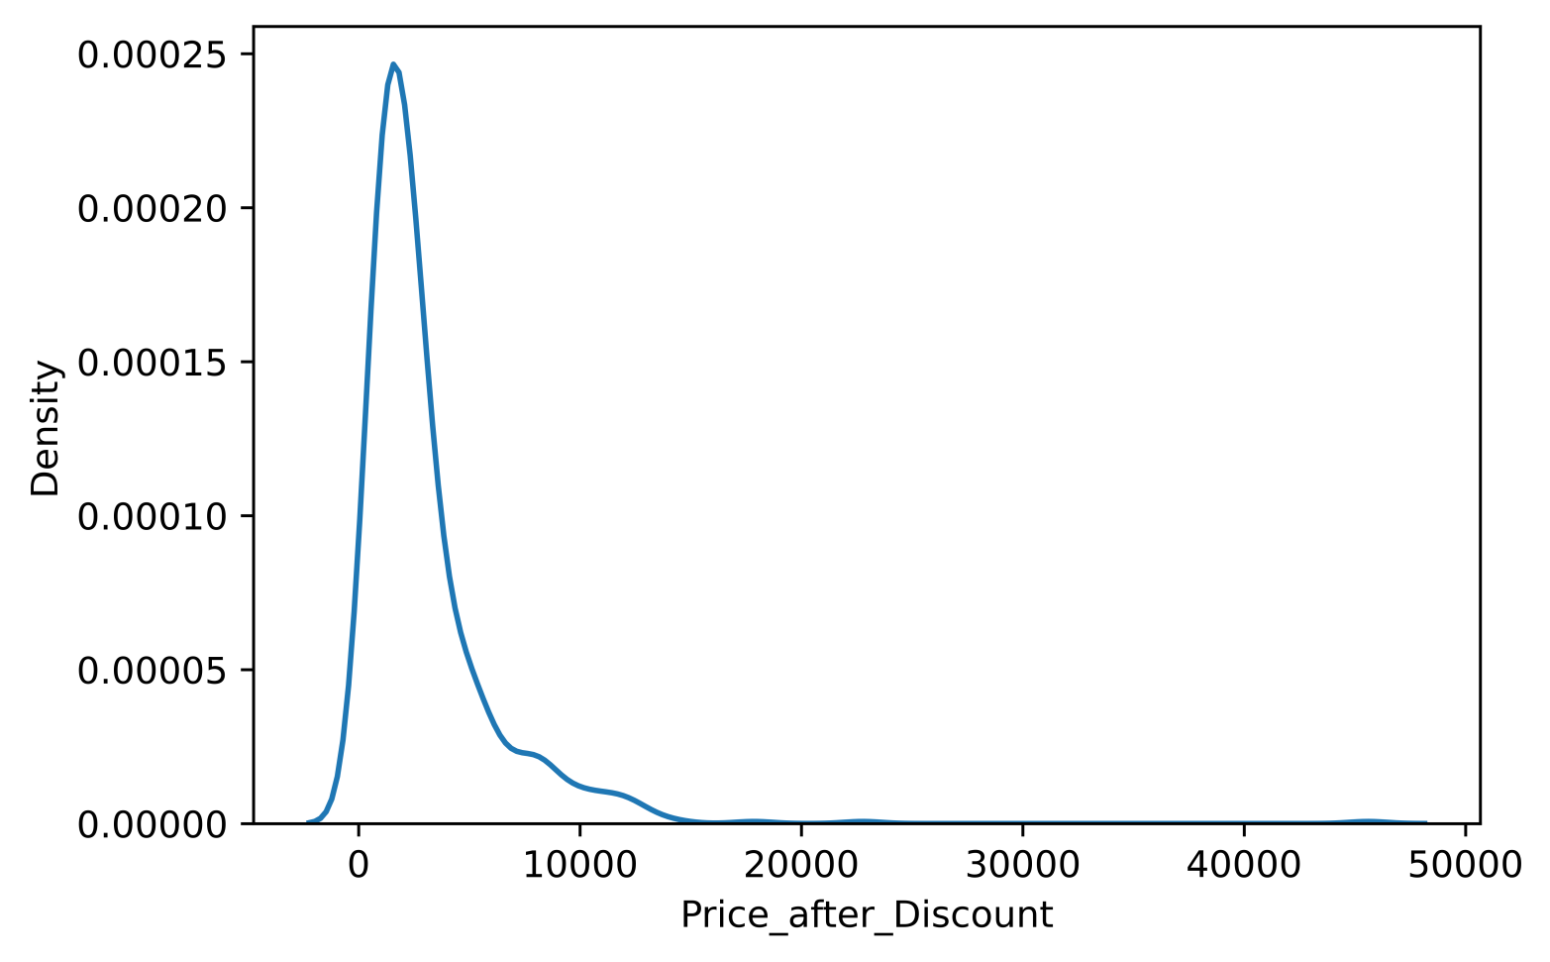
Distribution of prices between hotels
Most of the Hotels have a Price Range of 0-7000

Slide 9
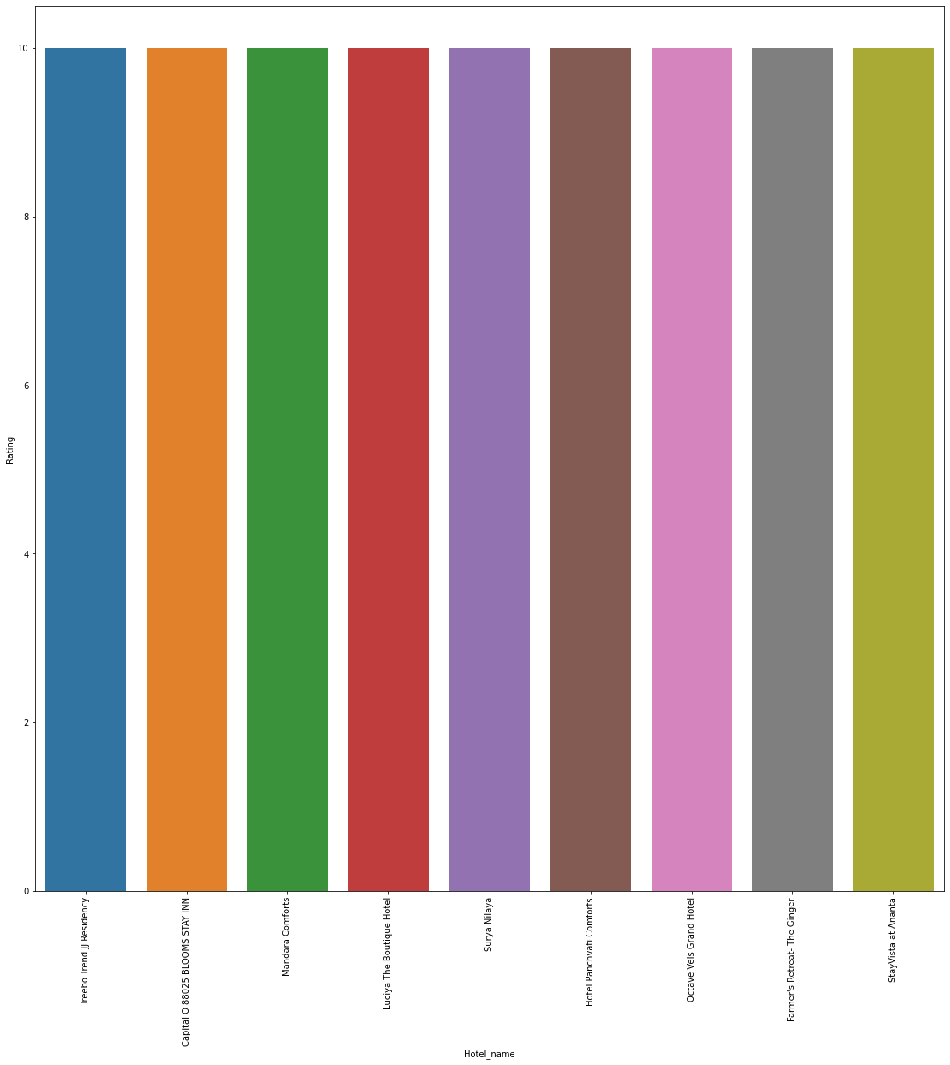
Hotels with Highest Rating i.e 10

Slide 10
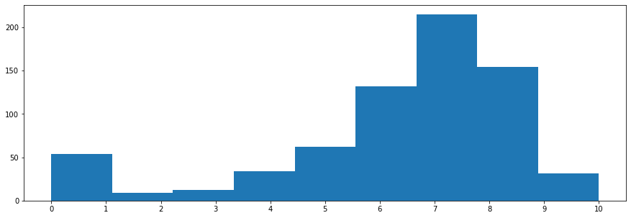
Distribution of ratings
No of Hotels
Ratings
Around 200+ Hotels have a Rating between 7-8

Slide 11
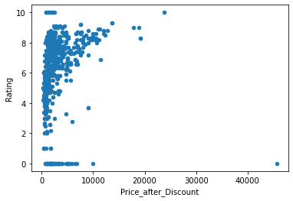
Prices and their ratings

Slide 12
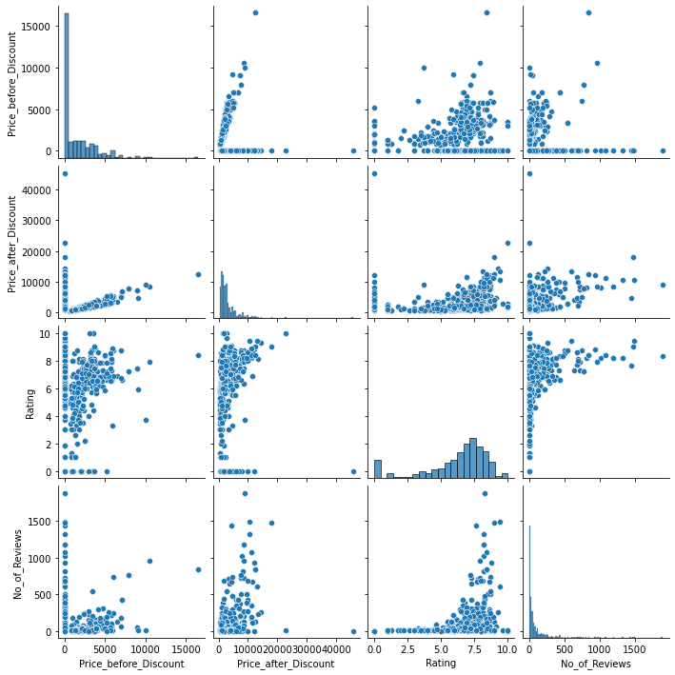
Pair-Plot to show Relation between all Numerical Data

Slide 13
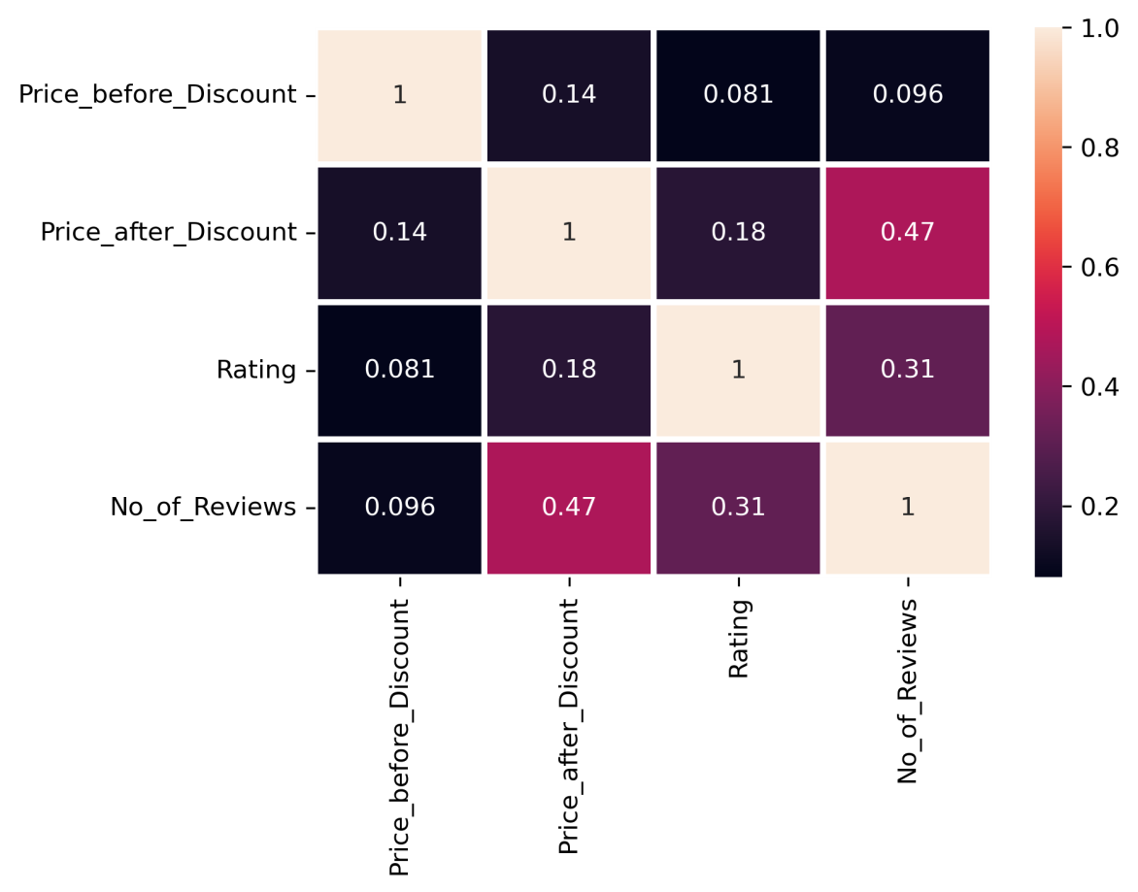
Correlation Graph

Slide 14
Conclusion
What if someone asks to show them Hotels with less prices and High Ratings
Top 5 Hotels to stay with Affordable Price and Good Ratings
Name | Price | Rating
Capital O 88025 BLOOMS STAY INN | 666 | 10
RVR Abode | 1695 | 10
Hotel Panchvati Comforts | 2100 | 10
Octave Vels Grand Hotel | 1300 | 10
Farmer's Retreat- The Ginger | 2500 | 10

Slide 15
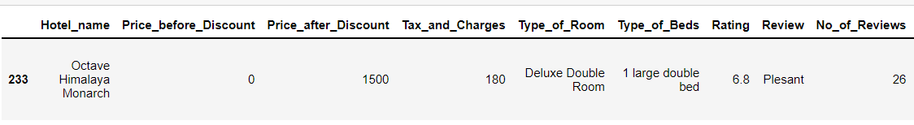
Scenarion where a person asks for a hotel name with plesant rating,1500 budget ,deluxe double room and a large double bed

Slide 16

THANK YOU

